Slide 1
Pima Indians and Diabetes Characteristics
Data Analysis
By Abdullah Umar, Joshua Herman, and Hamza Shahid

Slide 2
Background
The Pima Native American Indians have been suffering from one of the highest rates of diabetes in the world, and this has intrigued researchers for years.
Given the high rate of diabetes in Pima Native American Indians, they suffer from poor health conditions. In the USA this dataset is originally from the National Institute of Diabetes and Digestive and Kidney Diseases.

Slide 3
Identifying the Problem / Proposal Solution
Predicting the outcome of type-2 diabetes (1) or no diabetes (0) for a sample of females from the Native American Tribe Pima Indians
Explore diagnostic variables by using regression and classification to find the highest contributing factors and best predictors for the outcome of diabetes

Slide 4
Describing the Dataset/ Preparation
Attributes:
Pregnancies, Glucose, Blood Pressure, Skin Thickness, Insulin, BMI, Diabetes Pedigree Function, Age
Target: Outcome (1 for Diabetes, 0 for not Diabetes)
Accounted for missing data in Blood Pressure, Skin Thickness, BMI, Insulin, and Glucose by taking means and filling missing values
Skin Thickness and Insulin had a high number of missing values

Slide 5
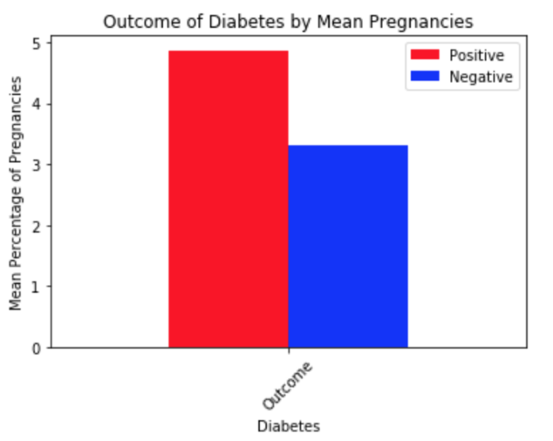
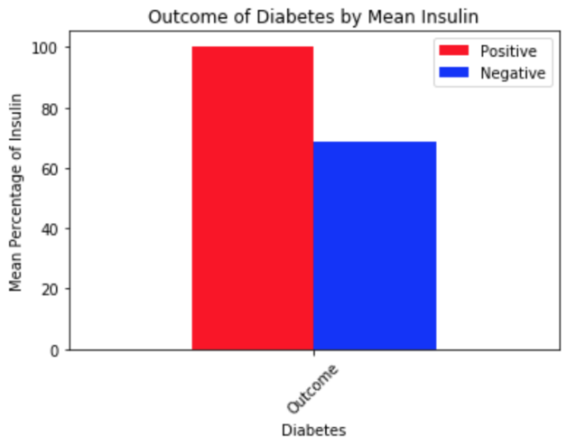
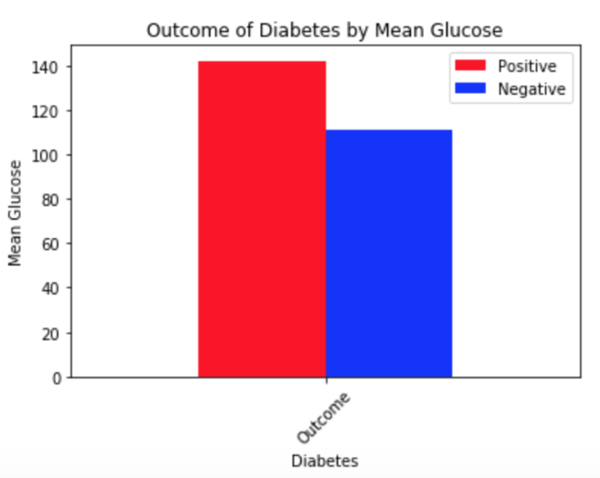
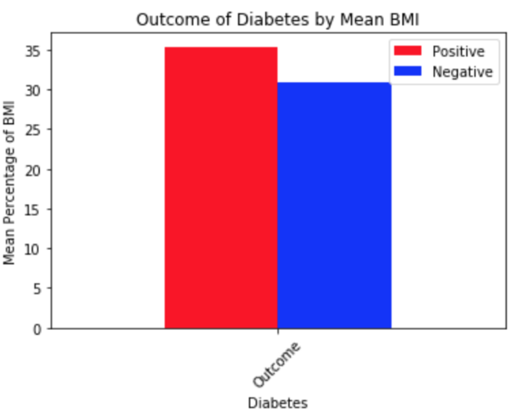
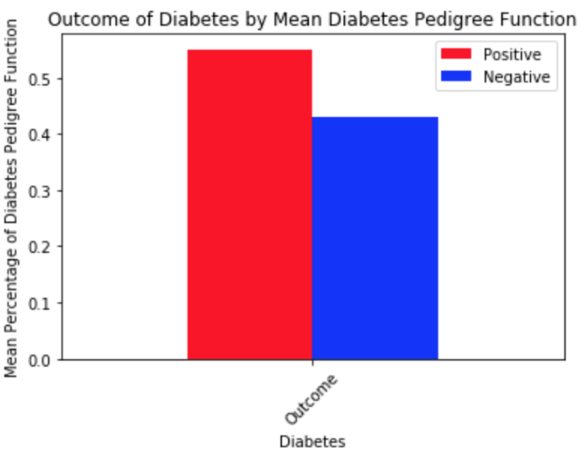
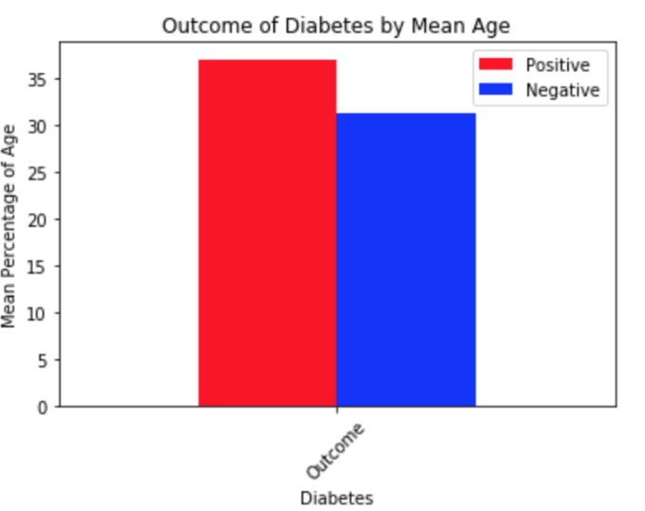
Exploratory Data Analysis

Slide 6
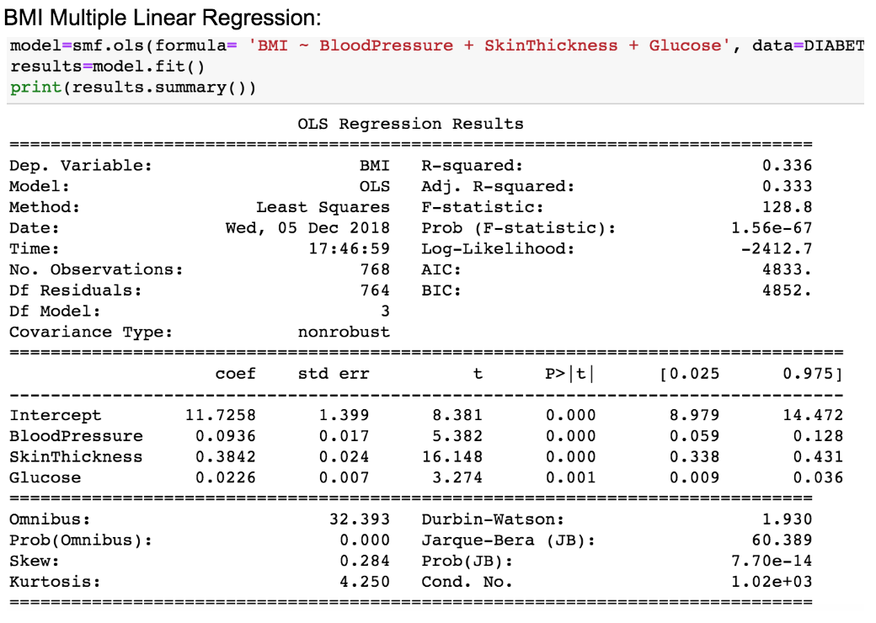
Data Modeling: Regression
We wanted to test the important quantifiable predictors we thought were contributors to diabetes, blood pressure, glucose, and BMI.
We wanted to see what variables are good at predicting blood pressure, glucose, BMI. Then using the best predictors of these for a multiple linear regression model used in out models for classifications.
The relationship between BMI and
BP, Skin thickness, glucose had
The highest R^2 value of 0.336

Slide 7
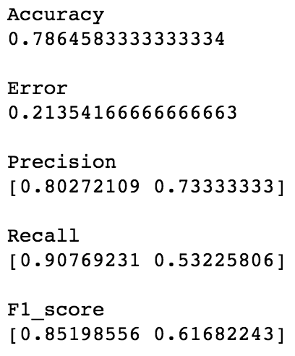
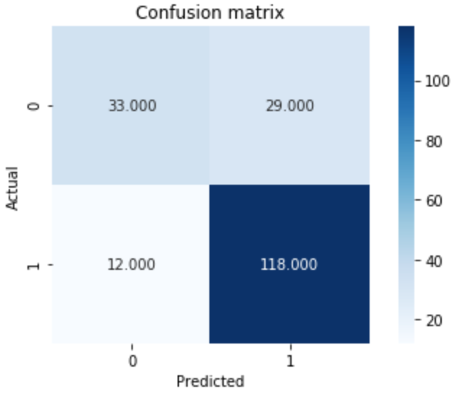
Data Modeling: Classification
Performed classification on the following models:
Everything grouped together
Highest difference in means grouped together
Pregnancies, glucose, insulin, BMI, DPF, Age
Lowest p-values grouped together
Glucose, BMI
Highest r-squared in multiple regression grouped together(multiple techniques)
BMI, blood pressure, skin thickness, glucose
BMI, blood pressure, insulin, glucose, age
BMI, blood pressure, age, glucose
Best model (BMI, Blood Pressure, Skin Thickness, and Glucose)
Accuracy = 0.7865
F1_score = 0.8520
R^2 = 0.336

Slide 8
Conclusion and Reflection
We should not have filled in the means for skin thickness and insulin
It was missing many values, enough to warrant deleting the attribute, could have lead to inaccuracies keeping it
If we had more data this would have been easier to do
Biology and the situation of the Pima Indians is complex and the things that lead to and cause type-2 diabetes is much more complex than the data we have to work with here
Better data and more attributes would lead to better predictions
Applications of the things we learned in this dataset could lead to interesting future studies on a dataset of a more general population
BMI, Blood Pressure, Skin Thickness, and Glucose ended up being our best predictors for diabetes in this population
Age and insulin were also good predictors

Slide 9
Sources
https://www.kaggle.com/uciml/pima-indians-diabetes-database/home
https://www.cdc.gov/media/releases/2017/p0718-diabetes-report.html
https://www.washingtonpost.com/archive/lifestyle/wellness/1993/03/30/why-are-the-pima-indians-sick-studies-on-arizona-tribe-show-excessive-rates-of-diabetes-obesity-and-kidney-disease/1f978958-e73b-483a-9af9-47d9efdad534/?utm_term=.f65b50af2565

